Slide 1
Category review: Chips
June 2020
Retail Analytics
Brand note: If client logo is not required, use alternate title page layout right click slide thumbnail > Layout > Title

Slide 2
Notes:
To view Privacy video explaining how important data privacy is to Quantium, please click here: https://www.youtube.com/watch?v=Zq1QDAkoRzU
or here Q:\Company Reference\Brand & Design\Brand videos\Q Privacy.mp4
At Quantium, we believe that data is the behavioural footprint of humanity and that it has to be treated with the utmost care and responsibility.
Histories, attitudes, indeed lives are stored within it in ways that aren’t always apparent – and that’s what makes its potential so powerful.
To work with it responsibly, sensitively, we set ourselves the highest data privacy protection and governance standards.
We have spent 17 years perfecting privacy-by-design and secure-by-design principles. Central to this is not holding any personally identifiable information about people –
we neither receive it, and put the necessary protections in place to be unable to decipher it.
Every aspect of handling data is safeguarded: from its de-identification, to its encryption – data security is paramount and of the highest grade.
We pride ourselves on gaining the trust of iconic organisations around the world through years of securely working with their data,
and in turn the trust that builds with their stakeholders.

Slide 3
Executive summary
01
Task 1
Customer Segmentation: Mainstream Young Singles & Couples are the primary shopper of chips. Young and Older Families make up 26% of Chips shoppers and on average purchase larger baskets. There is more opportunity for sales with these shoppers..
Sales Trends: The number of chips transactions dramatically increases prior to Christmas. Thus, added visibility to customers via a promotional display or Gondola end would increase purchases driving sales growth over this holiday period.
Product Attributes: Pack size and brand preference are critical factors influencing purchasing behavior, with larger packs and premium brands being more popular.
02
Task 2
Trial Impact: Stores 77 and 88 experienced significant sales increases compared to their control stores, suggesting a successful trial impact. Store 86 did not show a substantial difference, indicating a potential issue with trial implementation or execution.
Sales Comparison: Adjustments and scaling factors showed clear performance differences, validating the trial's effectiveness in certain locations.

Slide 4

01
Category

Slide 5

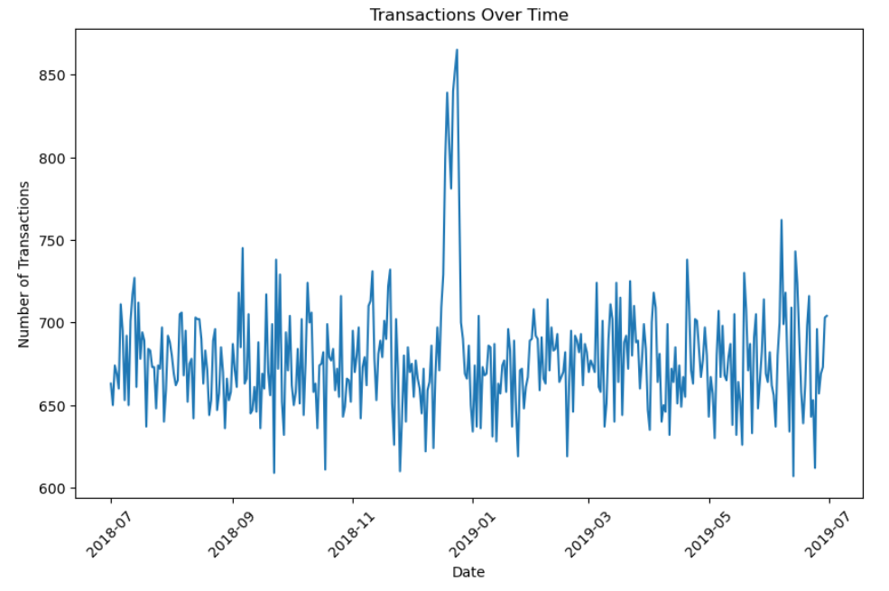
The number of Chips transitions has remained relatively consistent over the last 52wks; a notable increase occurred in the week leading up to Christmas
The total number of transactions in
the week including Christmas was
negatively affected by public holiday
store closures

Slide 6

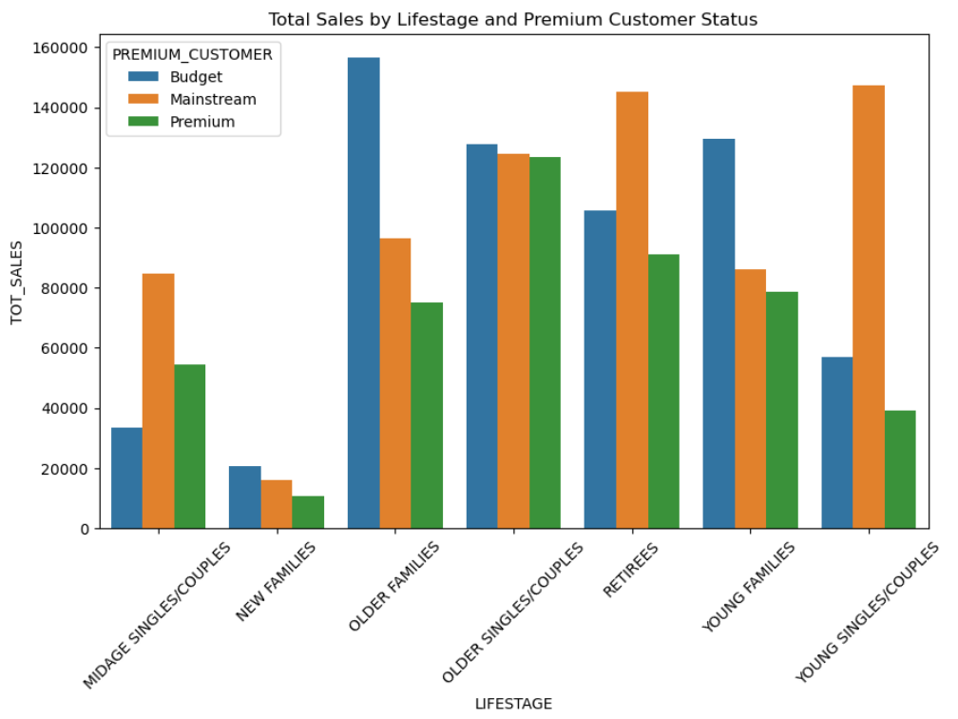
Mainstream Young Singles & Couples make up the largest proportion of Snacking Chips shoppers; Mainstream Retirees also have a significant share

Slide 7

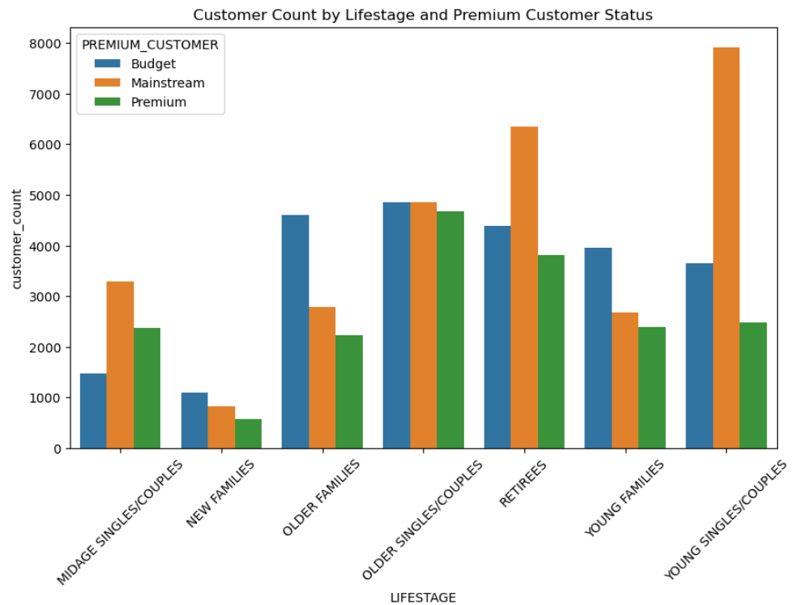
Editable (delete this)
Affluence appears consistent across each individual life stage profile; Older and Young Family shoppers purchase the highest avg units per transaction

Slide 8

02
Trial store performance

Slide 9
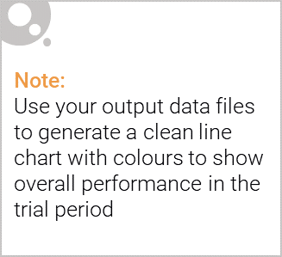
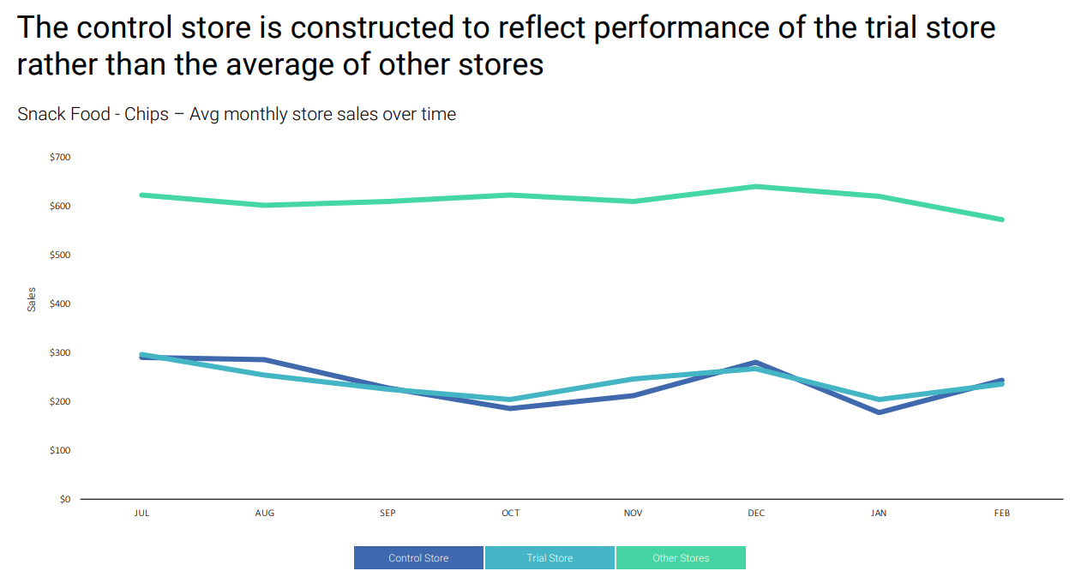
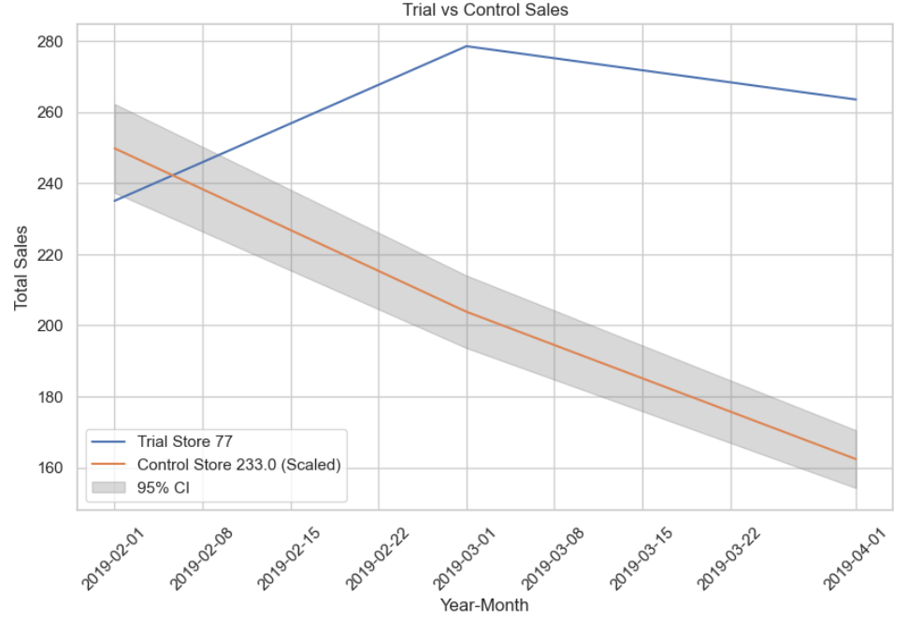
Significant difference between trial and control sales in at least two out of three trial months.

Slide 10

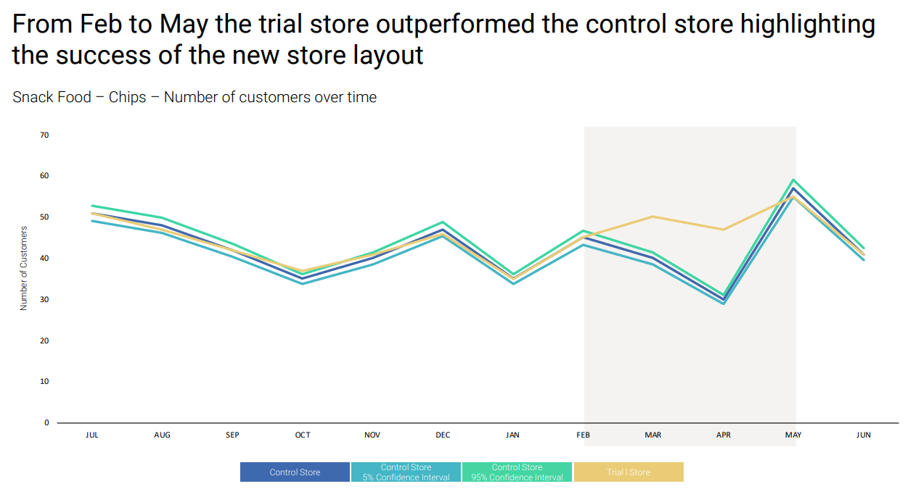
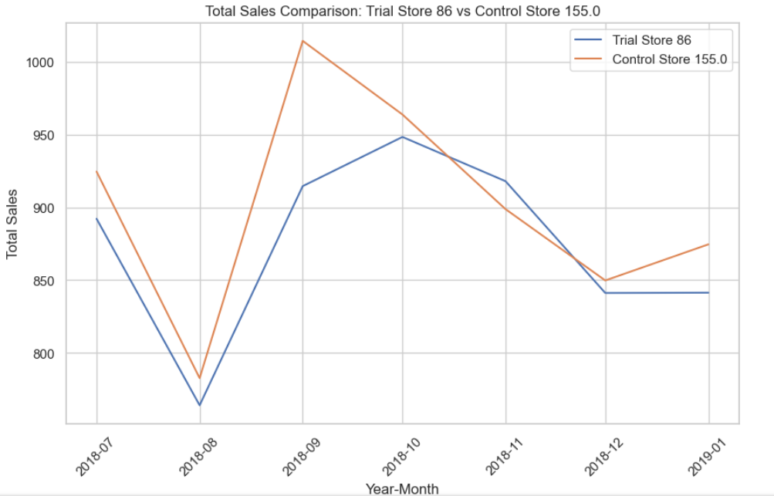
Trial Store 86: The trial did not show a significant difference compared to the control store.Trial Store 88: Significant difference between trial and control sales, with the trial store performance lying outside the confidence interval in two out of three months.

